Slide 1
VEC Refresh
Billing Review
December 10, 2013

Slide 2
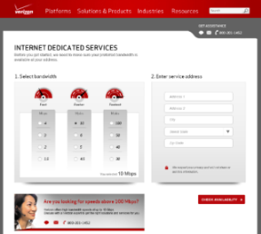
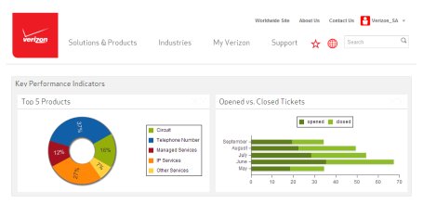
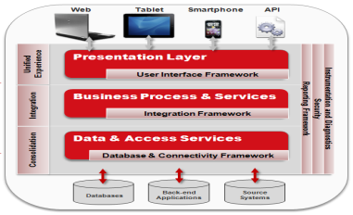
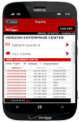

VES Online Self-service 2014 Focus Areas:
Grow Revenue with eCommerce |  | Driving $42M incremental full year revenue ($50M Stretch target) Focused on Internet, VoIP, and Cloud for business Adding over 10 new products
Unified Customer Experience |  | Centralized UI Guidelines Global Navigation SSO & Access Authorization Portal Consolidation Common Function Consolidation
Infrastructure Simplification & Elevation |  | Simplified infrastructure and environment Easier support and deployment simplification Active-Active capabilities for high-availability fail-over SOA architecture for improved integration design
Online Self-service Enhancements |  | Usability enhancements for key transactions Entitlement simplification for users Smart entitlement automation Registration simplification & enhancements Singular process for all registrations

Slide 3
Benefits
Customer
Iry
Usability redesign to create an environment that makes it easier for our customers to do their online tasks
Improved performance and enhanced UI design that improves the user experience
Clear and direct calls to action that simplify finding what you need
Consistent and uniform processes for all VES products to build familiarity and confidence in using our online self-service tools
Billing
Iry
Architecture simplification by using SOA approach
Operational saving by identifying impacted team rather than involving multiple teams to identify an issue – clear delineation and business logic to clearly identify business areas
Reusable services by VEC, CRM and Mobile
VAM provides data-only and does not have to deal with presentation

Slide 4
New VEC Production Roadmap
Iterative/Agile Approach
New VEC Pilot
Alpha
Beta

Slide 5
Overall Billing Phase 1 Scope – March Release
List of billing accounts with invoices
Inquiries
Listing of billing accounts / invoices
Inquiries
.pdf of most recent invoice
View account summary
Payment status
Create Inquiry
Inquiry Status
Update Inquiry
Account summary
Payment
Account summary
Account activity
List of current invoices in VAM
Change Address
Manage paperless
Current Invoice Summary
Payments
Payment tracking
Search
Payment Receipt
Make Payments
Manage Payment Accounts
Payment History

Slide 6
Approach
Architecture considerations - VAM
Architecture considerations – VAC
SOA, reusable services for each function
VEC Middle tier to call VAM for billing data
VEC to manage presentation details for services
Decouple tight integration between Portal Billing and ICI
Create reusable services for VEC/CRM/Mobile
VEC Middle tier to call VAC services for Inquiries
Current State
Future State
VEC
VBC
New VEC
CRM
Restful JSON API
VBCCIBR
VBCIBR
Integration Layer
VEC
Integration Layer
CRM
EJB Calls
Service calls with data only
BOSI
VAM / VAC
Service Layer
Stored Procedure Calls / Direct SQL
VAM / VAC
BOSI – multiple layers and owners
Need VAM to support a service layer API

Slide 7
VAM / VAC / ePayment Impacts – Billing Phase 1
VAM
VAC
Enhanced account, invoice, payment, and inquiry list
Account Summary (Account Activity & other integrated enhancements)
Inquiry Process – Paper Status, Real time Balance, Late Payment Charges, Payment History, Misapplied Payments, Adjustments
Online Payment Transactions
Search Payments
Search Invoice/Account
Create an Inquiry
Get Email List
Update Inquiry
Get Ticket Details
Add notes/comments
Close an Inquiry
Get Notes
Quick Status
Drop Down References
ePayment
Track Payments end to end – Portal – Epayments – AR – Billing Systems – VAM
Level 2 Payment Info – Epayments
Enhanced wallet screens UI

Slide 8
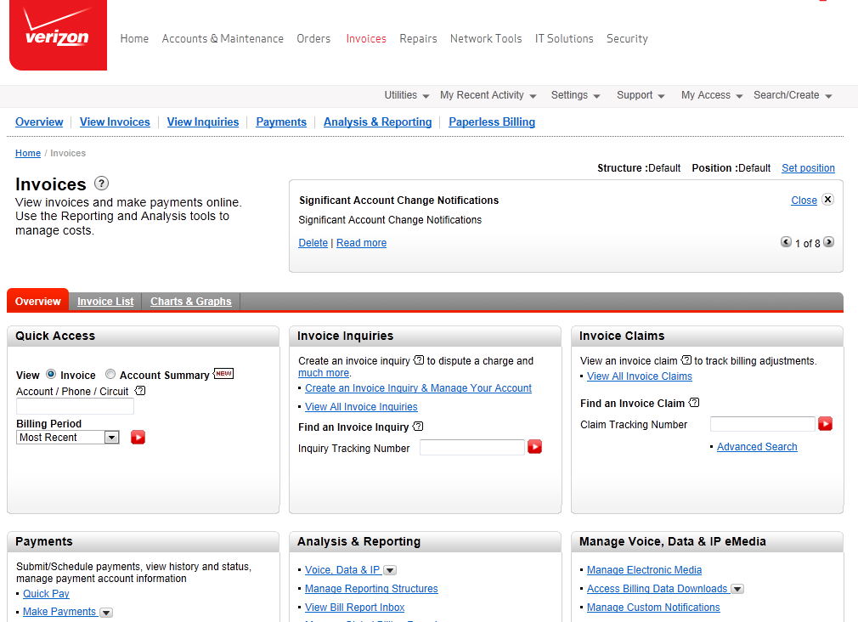
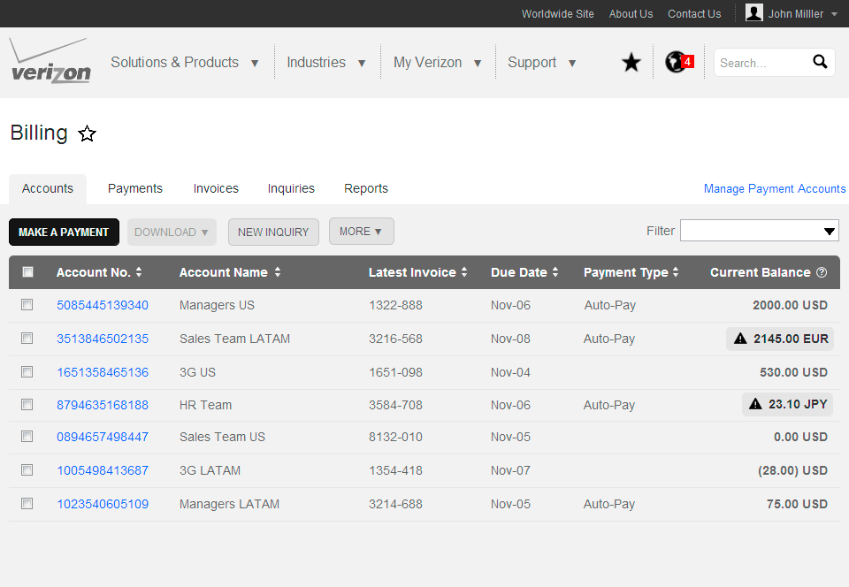
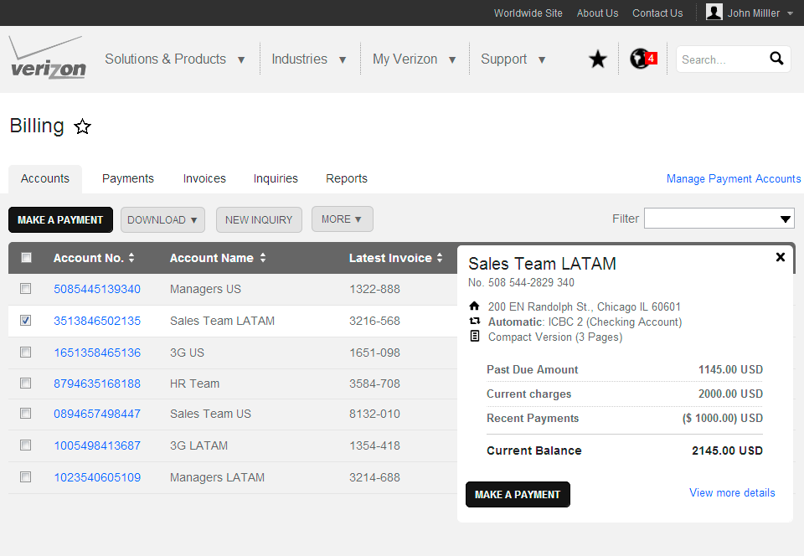
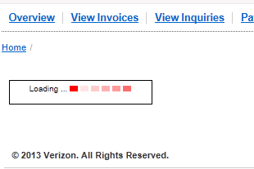
Redesigned Actionable First Page
Lots of Choices
Vs.
Clear Actions
New High-performance Architecture to avoid the marching red ants

Slide 9
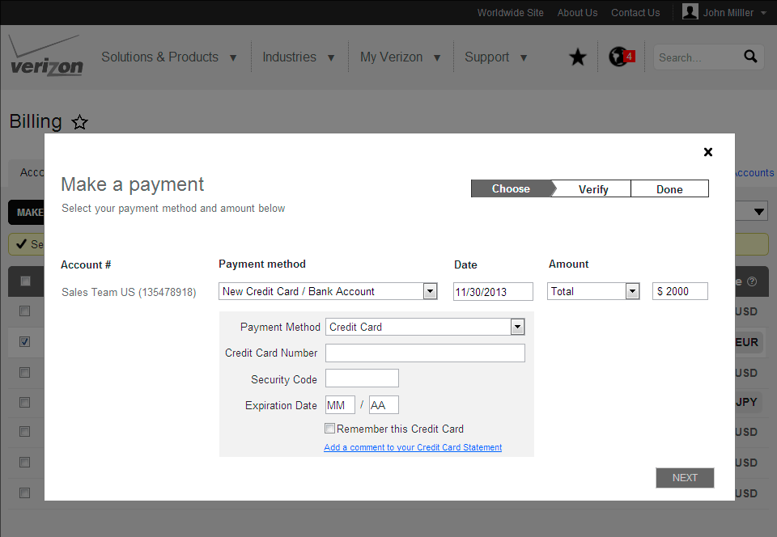
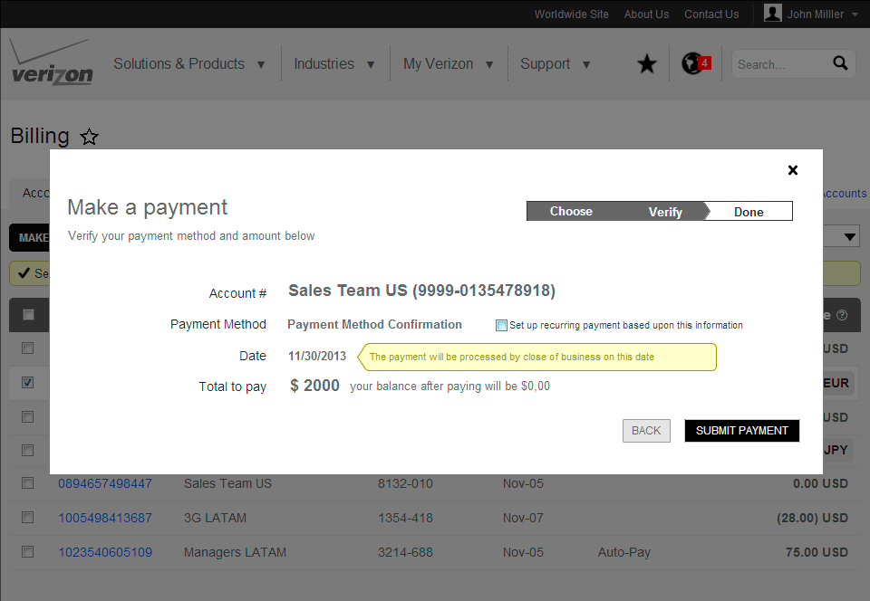
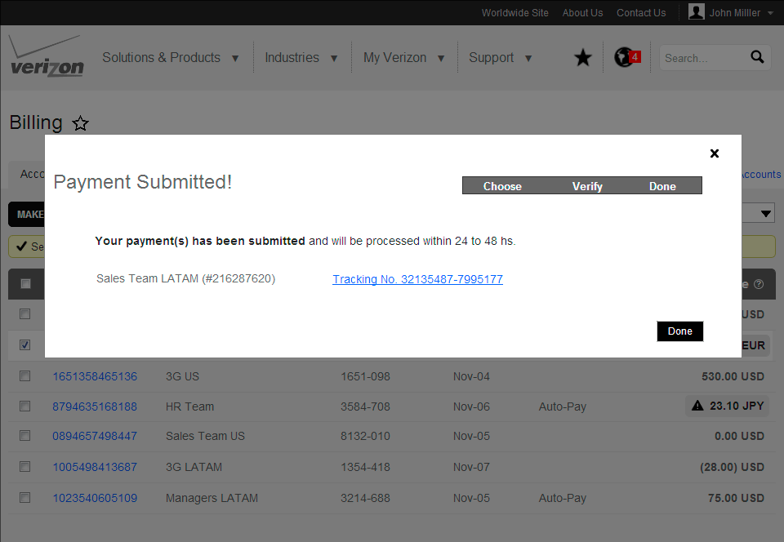
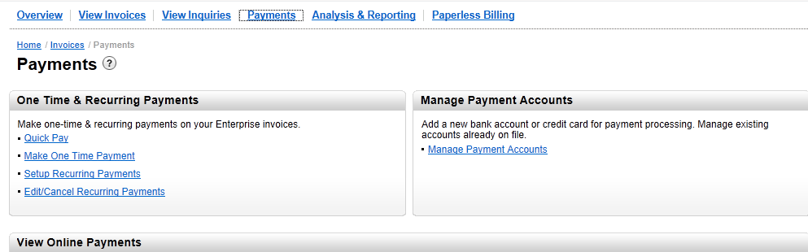
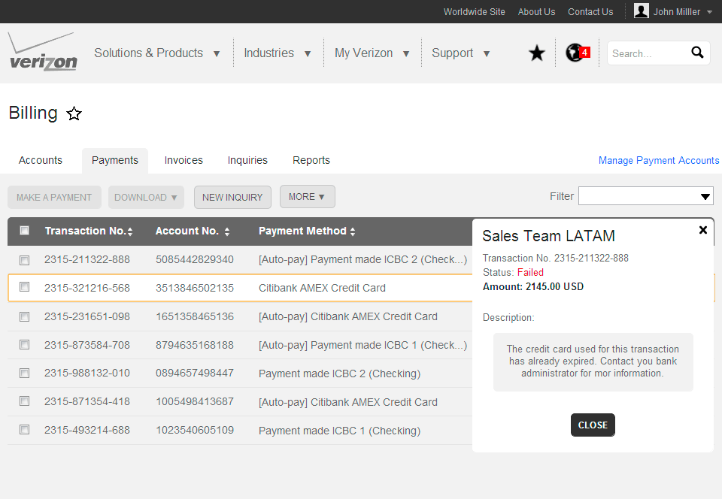
Redesigned Payments -Single Flow
All actions in one flow:
Know where you are in the payment process
Setup/Manage pay accounts
Make it Recurring (or not)
Solid Confirmation
Make a choice & repeat
Track the Status

Slide 10
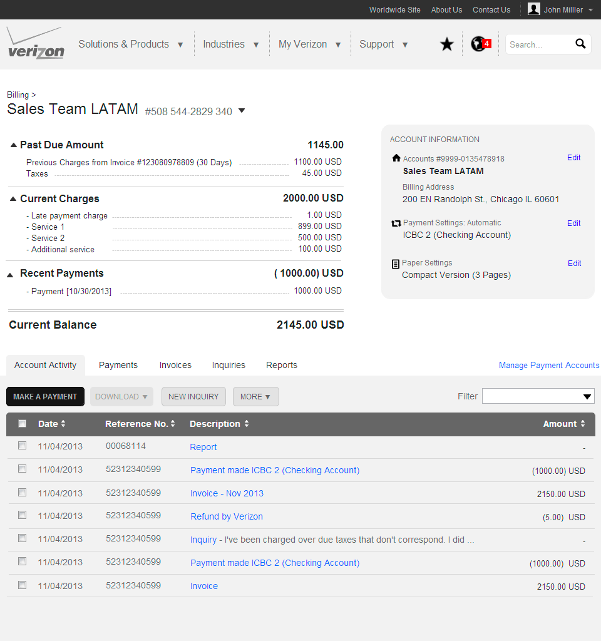
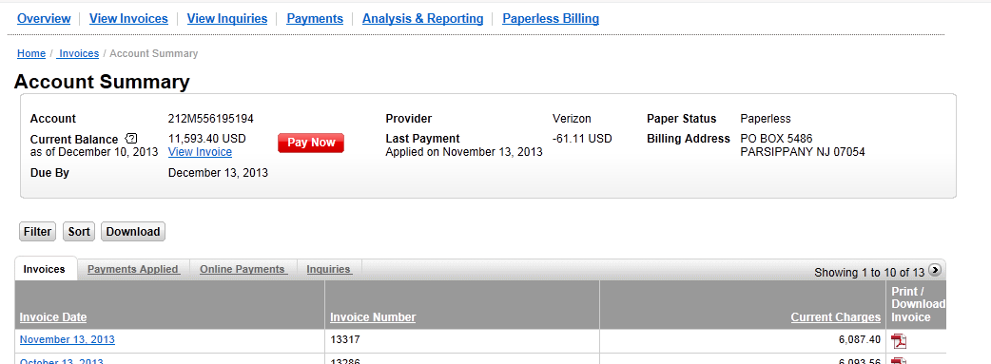
Improved Account Summary
New Account Summary is a good start
But we can improve it:
More detail
More actions
Account Activity history
Easy to find what you need

Slide 11
Billing Phase 2
Billing Phase 2
Online Bill View
eMedia
GBR
Downloads
Reporting
GDA (Global Data Analyzer)
Commitment Monitoring
Memo Bill Distribution
Wireless Punchthrough
Anonymous Ticket Creation and Status
OMR (Optional Management Reports)
Charts / Graphs
Need to determine scope and design for phase 2
Follow up 2nd week of January on phase 2
Targeting before 3Q

Slide 12
Next Steps
Iry
VAM and VAC agreement to support for March release – ACTION ITEM: Dave / Jeff – ETC 12/18
Identify billing key points of contacts to start working on Interface Control Document (ICD) – ACTION ITEM: Dave / Jeff – ETC 12/18
Define high level timeframes for deliverables with VAM and VAC – ACTION ITEM: Fred – ETC 12/20
Support an agile development
Meet alternate days with billing POCs

